Slide 1
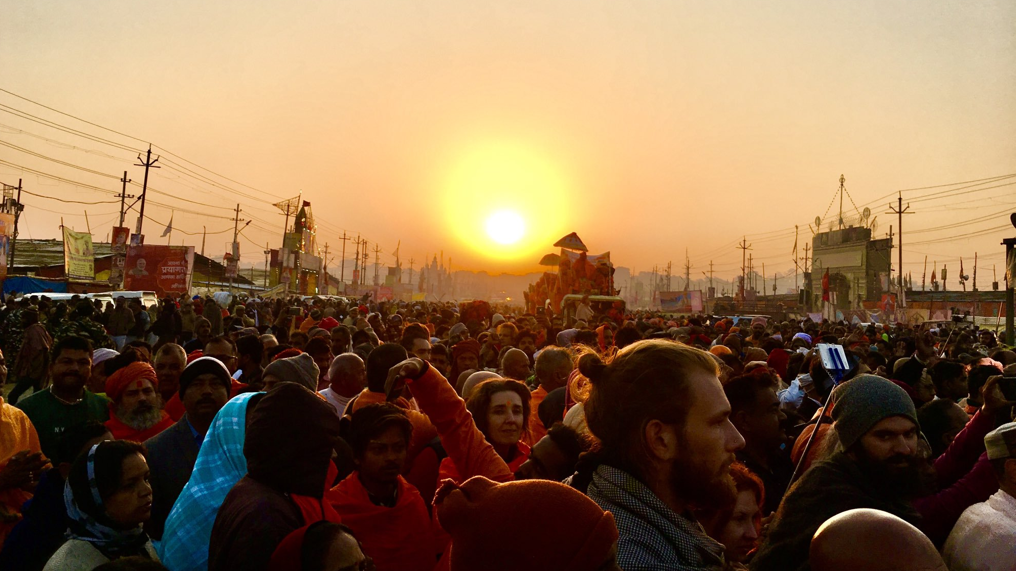

RESTARTING HINDI HEARTLAND
Opportunities in the post COVID-19 world
Prof. Prateek Raj, IIMB Webinar, 16th May 2020, 4 – 5 pm
Picture: 10/02/2019, Shahi Snan, Vasant Panchami, Kumbh 2019, Prayagraj

Slide 2
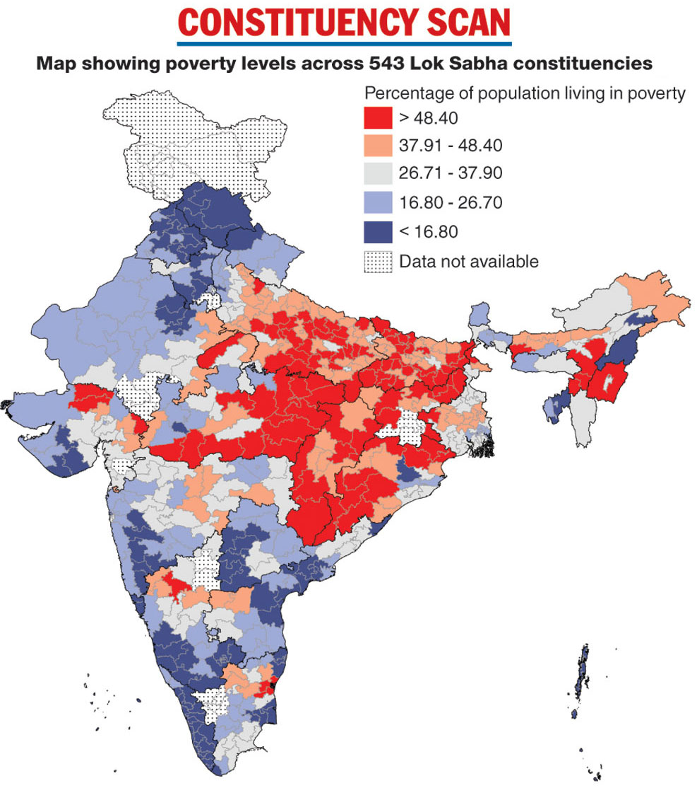
DIAGNOSIS: Hindi heartland was home to large globally renowned cities
Large historical cities of India until 1850
(>10% of the largest city in the world
World City Database)
Large historical cities have been found in all parts of India, and the region is no exception.
Source: https://www.telegraphindia.com/india/india-s-welfare-map-seat-by-seat/cid/1688973

Slide 3
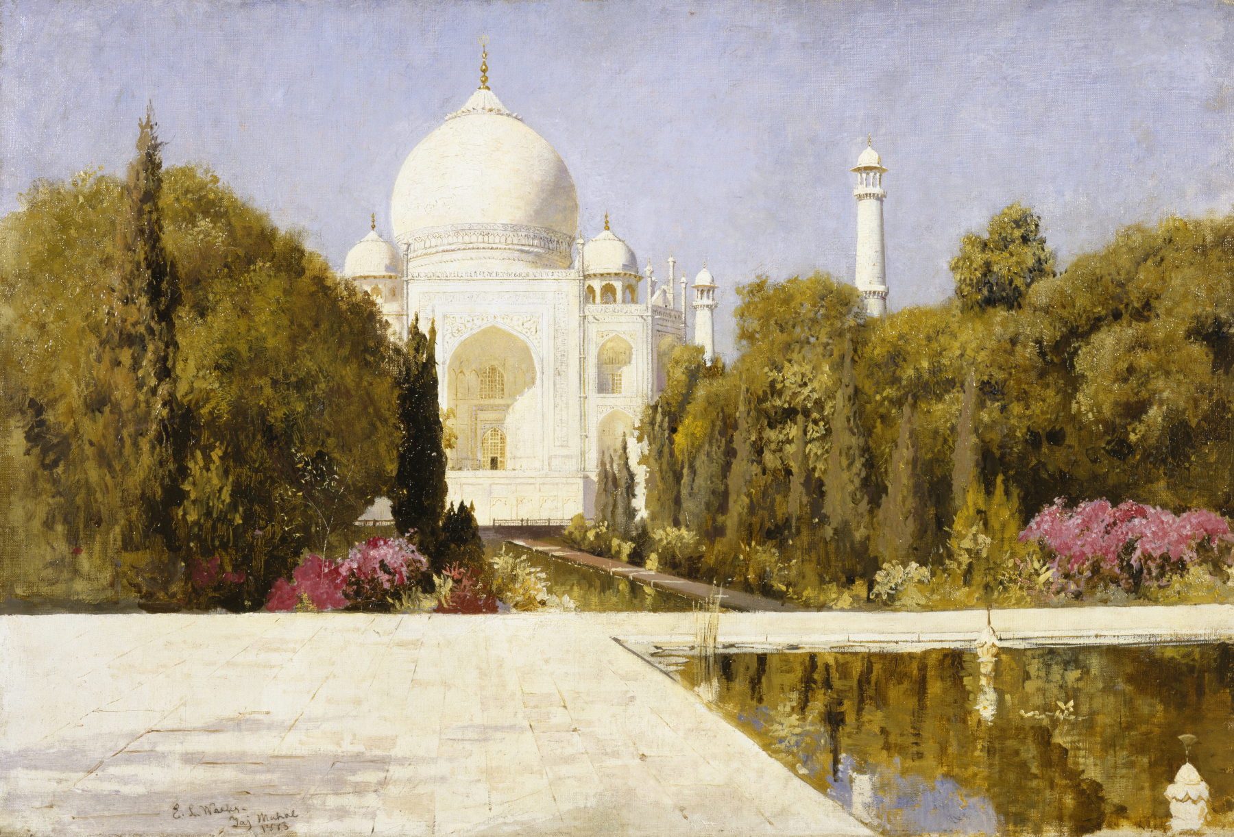

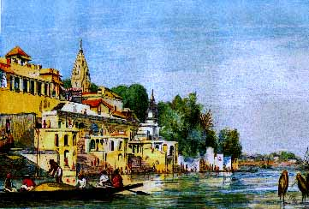
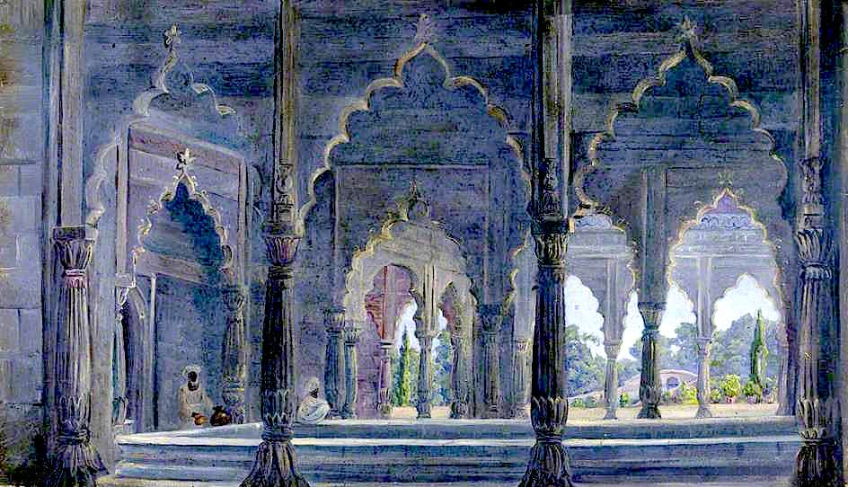
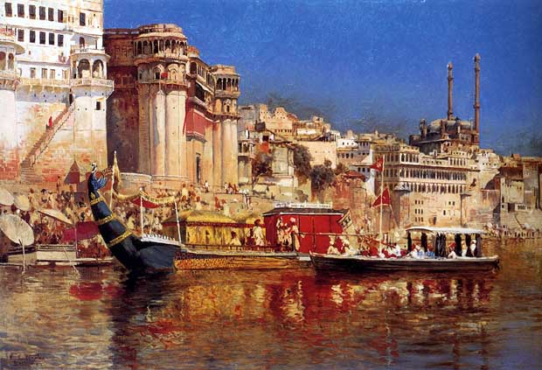
DIAGNOSIS: Hindi heartland was home to large globally renowned cities
Largest cities of India 1901
(Census 1901)
7. Delhi
5. Lucknow
10. Agra
9. Kanpur
8. Ahmedabad
6. Varanasi
1. Kolkata
At the dawn of 1900s, 4 out of top 10 Indian cities- Agra, Kanpur, Lucknow and Varanasi were in the region. Kanpur and Lucknow were still among top 10 in 1991.
2. Mumbai
4. Hyderabad
3. Chennai
Source: https://www.telegraphindia.com/india/india-s-welfare-map-seat-by-seat/cid/1688973

Slide 4
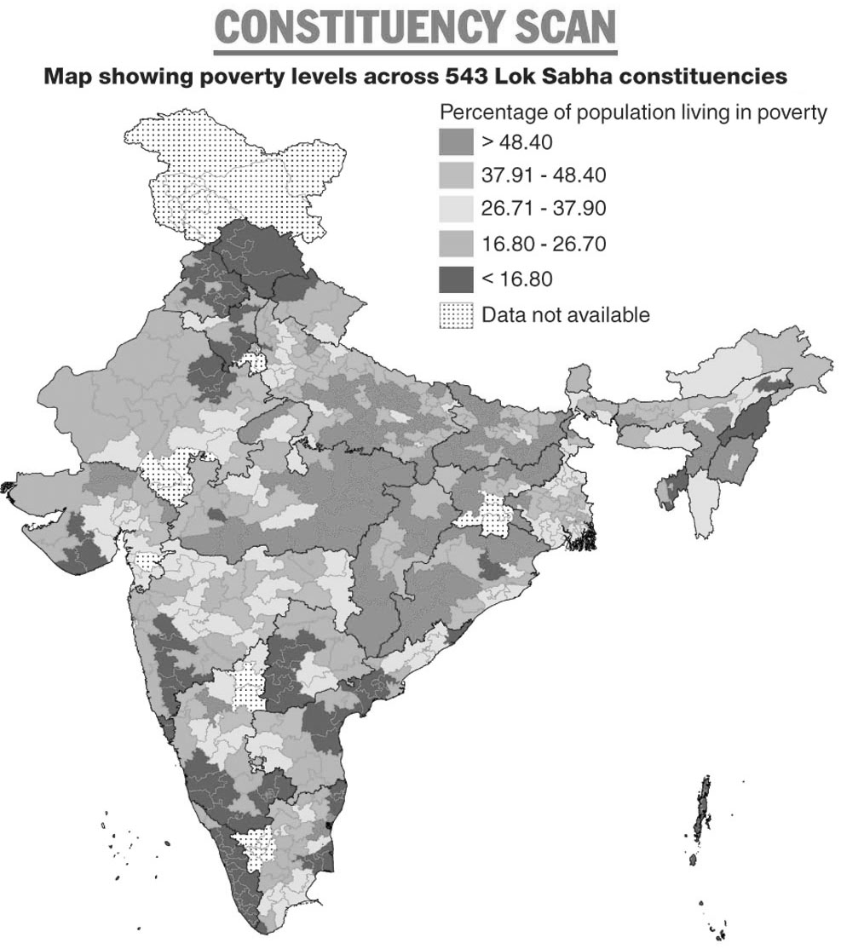
DIAGNOSIS: Region faces a metropolis vacuum and losing global relevance
Largest cities of India 2011
(Census 2011)
2. Delhi
10. Jaipur
7. Ahmedabad
3. Kolkata
9. Surat
Cities of the region have failed to grow relatively since 1991, with has led to a “metropolis vacuum” in the region.
1. Mumbai
8. Pune
6. Hyderabad
5. Bengaluru
4. Chennai
Source: https://www.telegraphindia.com/india/india-s-welfare-map-seat-by-seat/cid/1688973

Slide 5
DIAGNOSIS: Region has high poverty levels, and low per capita income
Goa
Delhi
2. Delhi
Sikkim
Chandigarh
10. Jaipur
7. Ahmedabad
3. Kolkata
Haryana
9. Surat
Puducherry
Lack of growth in the region has led to high levels of poverty, and low levels of GDP per capita (around 1000 USD)
Karnataka
Telangana
Uttarakhand
1. Mumbai
Tamil Nadu
Maharashtra, Kerala, Himachal Pradesh
Gujarat
8. Pune
Andhra Pradesh
Andaman and Nicobar
6. Hyderabad
Punjab
Mizoram
INDIA, Arunachal Pradesh
5. Bengaluru
Rajasthan, West Bengal
Nagaland, Tripura
4. Chennai
Chhattisgarh, Jammu and Kashmir, Odisha
Madhya Pradesh
Meghalaya
Assam, Jharkhand
Manipur, Uttar Pradesh
Bihar
Source: https://www.telegraphindia.com/india/india-s-welfare-map-seat-by-seat/cid/1688973

Slide 6
DIAGNOSIS: Post-liberalization flight of talent and labor from the region
About 50 cr people live in Bihar, Chhattisgarh, Jharkhand, MP and UP. Absence of a major city in such a large region is unnatural, and historically abnormal.
Source: https://www.telegraphindia.com/india/india-s-welfare-map-seat-by-seat/cid/1688973

Slide 7
STRATEGY: Reverse the flight – build attractive and inclusive markets
IIML,IIITL
IITK
MNIT,IIITA
IITV
IITP,NITP
Build economic clusters to attract enterprises, talent, capital with region’s youth, institutions and low costs, e.g., in manufacturing, agricultural processing.
Attractive markets
+
Enterprise
Capital
Talent
Source: https://www.telegraphindia.com/india/india-s-welfare-map-seat-by-seat/cid/1688973

Slide 8
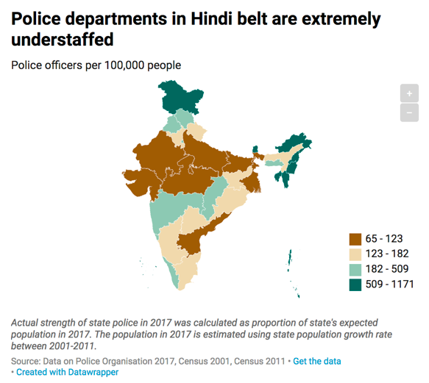
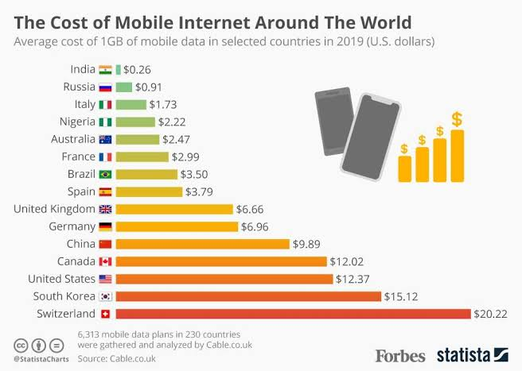
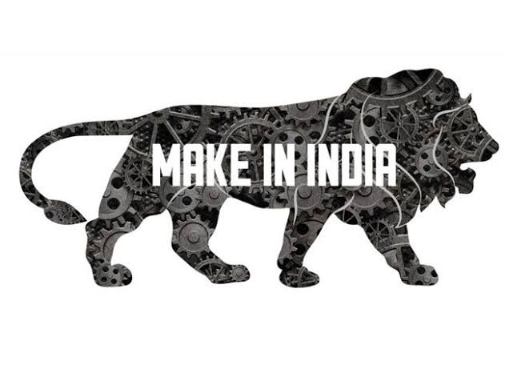




GOALS: Necessary ingredients of attractive and inclusive markets
The region by identifying and developing multiple regional economic clusters will
Encourage urban development of focal cities and adjoining towns
Encourage rural development of surrounding rural areas
Promote production of value-added and specialised products/services, marketable for a global economy.
Building strong and steady institutions
Ease of Doing Business*
Lowering transaction cost
Digital India, Industrial corridor, Smart City
Building trust and civic norms
Sabka Saath, Sabka Vikas
Source: Live Mint (2019)
Political uncertainty and weak rule of law (e.g. lynching) has marred region’s reputation. UP has second smallest police force per-capita. Weak institution is an impediment for being an attractive market, as businesses need *protection of life and private property, policy stability, contractual infrastructure.
The digital infrastructure has been successfully developed in India since 2000s. Transaction costs have been significantly reduced, favoring creation of attractive markets. Need for better information highways, and improved transport connections by building industrial corridors.
The region has multiple social groups and communities and is hyper-fragmented. Need to build a common inclusive identity around regional (like the south and west Indians states) and local (e.g. Indore) pride to build a shared vision.
Source: Raj, P., 2018. Evolution of Business and Markets. IIM Bangalore Dwijendra Tripathi Memorial Lecture

Slide 9
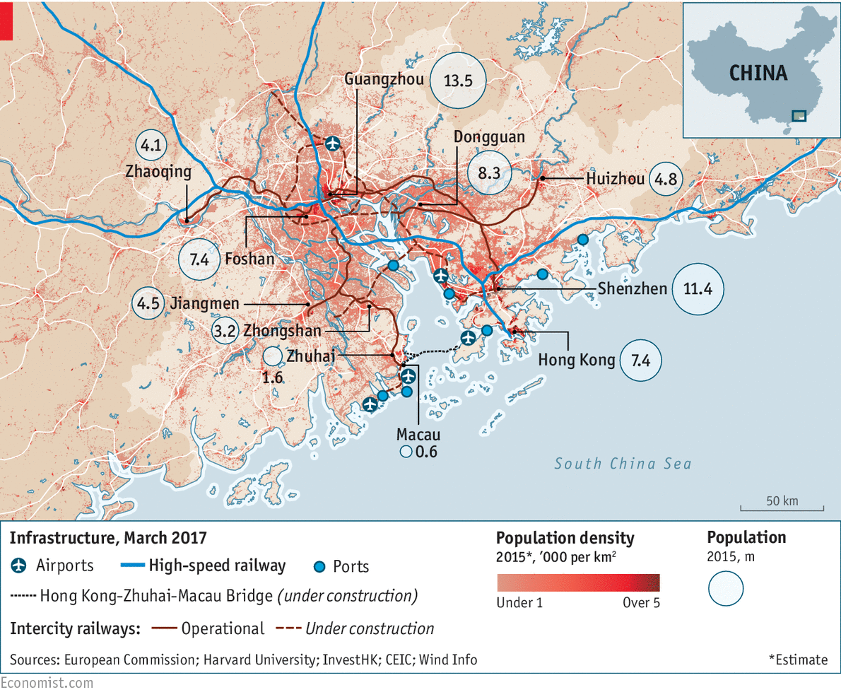
ECONOMIC MODEL: Learning from Pearl River Delta, China and Delhi NCR
Build autonomous clusters
Pearl river delta has manufacturing led economy with SEZs
GDP close to 2 trillion dollars
World Bank calls it a Mega City
One of its cities Shenzhen emerged from backwaters in 1970s to an alpha city (same as Delhi and Mumbai).
“None of this would have happened without free enterprise.” (The Economist)
Greater autonomy
Ability to set own policies, future direction and taxation (relaxed)
Delhi NCR (incl. Ghaziabad, Noida, Meerut) is India’s leading cluster.
Uttar Pradesh can follow this model of autonomous cluster formation, in Prayagraj-Varanasi and Kanpur-Lucknow economic clusters.

Slide 10
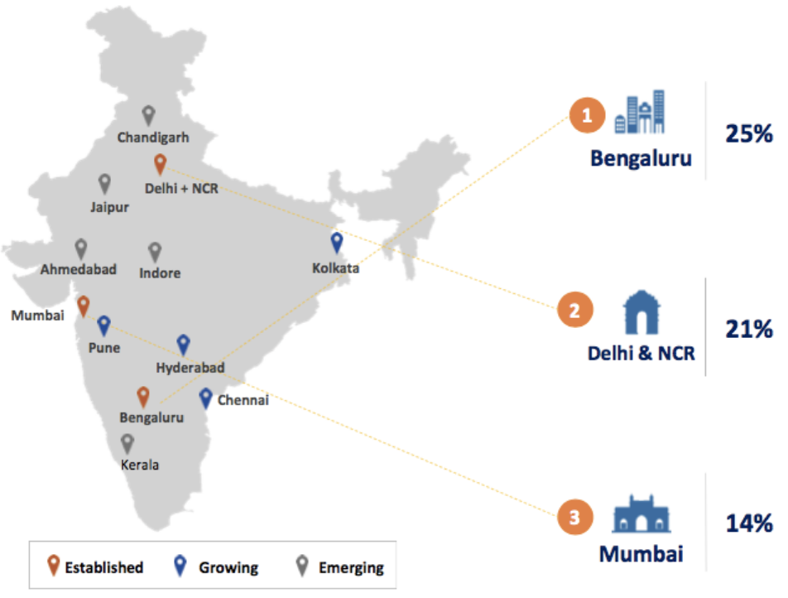
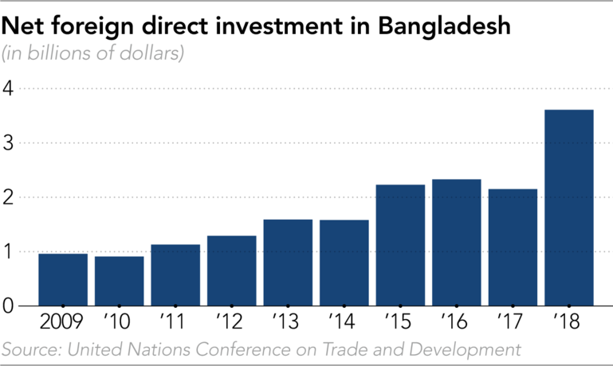
ECONOMIC MODEL: Learning from South India and Bangladesh
Economic Clusters
if public investments (health, education, credit)
Market inclusion / mobility
Balance people and profit: South India model
Growth and inclusion as complements
Focus on development of sustainable economic clusters (Bengaluru, Hyderabad)
Government uses revenue to support inclusion (e.g. public health, education)
Emphasis on free enterprise, human capital, and market inclusion
Emphasize self-sufficiency: Bangladesh model
Asian Development Bank called Bangladesh fastest growing economy in Asia-Pacific
Boom in manufacturing, infrastructure, FDI
Promoted self-sufficiency (less foreign aid) and regulatory certainty
Less restrictive labor laws enabling larger textile manufacturing plants (Mint)
Focus on women (health, education), economic inclusion (access to credit) (Mint)
Economic “philosophy is a blend of capitalistic and socialistic virtues.” (WEF)
Expansion &
Agglomeration
Private investment in self/kids
Growth
Moving up value chain
(milk to butter)
Human Capital
Puducherry
Karnataka
Telangana
Tamil Nadu
Kerala
Source: NASSCOM startup report (2018)
Andhra Pradesh
INDIA
BANGLADESH
Uttar Pradesh
Source: Adjusted rates based on MOSPI
Source: WEF
Source: Lucas R, 2018. What was the industrial revolution? Journal of Human Capital
Source: Raj, P., and Menon, M. S., 2019. South India’s Growth Model is Worth Emulating. Hindu Business Line

Slide 11
EXECUTION: Learning from 2019 Kumbh
IIMB study found the region’s administration showcased impressive urban planning/governance ability at Kumbh
Key performance factor | Learning from Kumbh | Learning for Economic Cluster
Clear Accountability | Established Mela Pradhikari Model who was empowered and fully accountable for Kumbh | Establish a Mayor (like a CEO) committed to the cluster (not rotating bureaucrats), fully accountable (elected/appointed) for cluster’s development and performance, as well as empowered to take key decisions. (alternative models of leadership also exist)
Mission Based | Set clear performance guidelines: Safety, Cleanliness, Sanitation | Set clear performance guidelines: Deadline, Monitoring, Implementation for improving basic infrastructure (roads, rail, bridges), amenities (water, hospitals), public places (city center, museums, libraries), universities etc.
Focused Attention | The government committed to Kumbh, international media created “do or die” performance pressure | The government has committed to a trillion dollar economy, promote and respect critical media and civil society who create “do or die” performance pressure.
Decentralized Governance | Utilized diverse governance models for different days and districts in cooperation with stakeholders (e.g. Akhadas) | Government is only a (key) player in governance. Local initiatives by stakeholders: public/private/civic institutions esp. universities (e.g. startup, apprenticeship hubs) should be supported and incorporated. Build a local council (Mahajanpad) for stakeholder engagement.

Slide 12
SUMMARY: Path of Hindi Heartland to growth is through clusters
Region needs >10% GDP growth: The low income region faces a metropolis vacuum and outmigration since liberalization. For >10% growth
Build economic clusters: e.g., in manufacturing
Emphasize market inclusion: e.g., by boosting agricultural processing
Empower local anchors: e.g., universities IITs, BHU, AU
Prioritize human capital: Offer MOOCs that teach portfolio of basic skills (invest in ITI), formal apprenticeships via university-industry collaborations
ACCOMPLISHED: Digital infrastructure, Salient cities, Leading universities, Voters/businesses united on substantial issues: jobs
TO BE DONE:
Rule of law: Expand per-capita police
Ease of doing business: Strengthen property rights and contractual infrastructure, ensure stable policy environment
Information and transport: Create information highways, and better inter/intra cluster connectivity by building industrial corridors
Shared vision: Monitor and improve quality of local civic amenities to build common inclusive identity around local pride [e.g. Indore]
STRATEGY
GOALS
Vision: Economic clusters
as vehicles of urban and rural development
promoting production of value-added and specialised products and services, marketable for a global economy.
ECONOMIC MODEL: Lucas model of growth
Develop autonomous economic clusters [e.g. NCR, Pearl River Delta]
Initial investor drive (GIMs) for PPP, WB/ADB, rationalization incl. optimal asset utilization
Invest revenue in inclusion, encourage fiscal self-sufficiency [e.g. South India, Bangladesh]
EXECUTION: Learn from Kumbh
Clear Accountability: Empower, accountable mayor
Mission Based: Clearly define performance guidelines
Focused Attention: Build space for media and civic groups to create performance pressure
Decentralized Governance: Set council for stakeholder engagement esp. universities (startup, apprenticeship)

Slide 13
Appendix

Slide 14
Largest cities of India 2001
Source: https://www.telegraphindia.com/india/india-s-welfare-map-seat-by-seat/cid/1688973

Slide 15
Largest cities of India 1991
Source: https://www.telegraphindia.com/india/india-s-welfare-map-seat-by-seat/cid/1688973

Slide 16
Largest cities of India 1981
Source: https://www.telegraphindia.com/india/india-s-welfare-map-seat-by-seat/cid/1688973

Slide 17
Largest cities of India 1971
Source: https://www.telegraphindia.com/india/india-s-welfare-map-seat-by-seat/cid/1688973

Slide 18
Largest cities of India 1961
Source: https://www.telegraphindia.com/india/india-s-welfare-map-seat-by-seat/cid/1688973

Slide 19
Largest cities of India 1951
Source: https://www.telegraphindia.com/india/india-s-welfare-map-seat-by-seat/cid/1688973

Slide 20
Largest cities of India 1941
Source: https://www.telegraphindia.com/india/india-s-welfare-map-seat-by-seat/cid/1688973

Slide 21
Largest cities of India 1931
Source: https://www.telegraphindia.com/india/india-s-welfare-map-seat-by-seat/cid/1688973

Slide 22
Largest cities of India 1921
Source: https://www.telegraphindia.com/india/india-s-welfare-map-seat-by-seat/cid/1688973

Slide 23
Largest cities of India 1911
Source: https://www.telegraphindia.com/india/india-s-welfare-map-seat-by-seat/cid/1688973

Slide 24
Largest cities of India 1901
Source: https://www.telegraphindia.com/india/india-s-welfare-map-seat-by-seat/cid/1688973

Slide 25
Largest cities of India 1801
(World City Database)
Source: https://www.telegraphindia.com/india/india-s-welfare-map-seat-by-seat/cid/1688973

Slide 26
Largest cities of India 1701
(World City Database)
Source: https://www.telegraphindia.com/india/india-s-welfare-map-seat-by-seat/cid/1688973

Slide 27
Largest cities of India 1601
(World City Database)
Source: https://www.telegraphindia.com/india/india-s-welfare-map-seat-by-seat/cid/1688973

Slide 28
Largest cities of India 1501
(World City Database)
Source: https://www.telegraphindia.com/india/india-s-welfare-map-seat-by-seat/cid/1688973

Slide 29
Largest cities of India 1001
(World City Database)
Source: https://www.telegraphindia.com/india/india-s-welfare-map-seat-by-seat/cid/1688973

